Slide 1


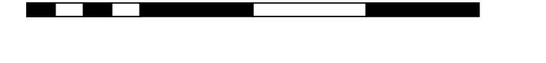
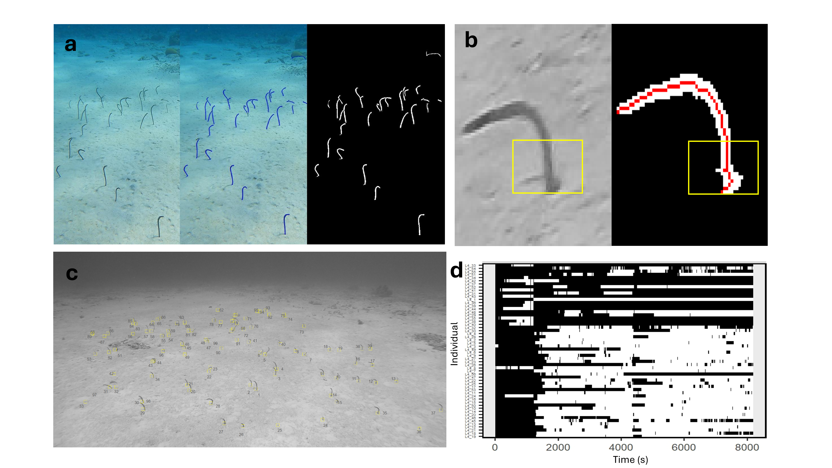
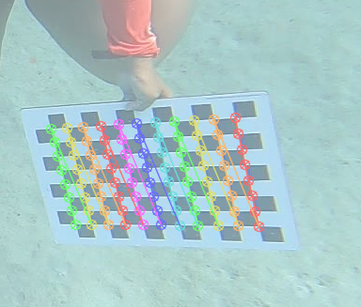
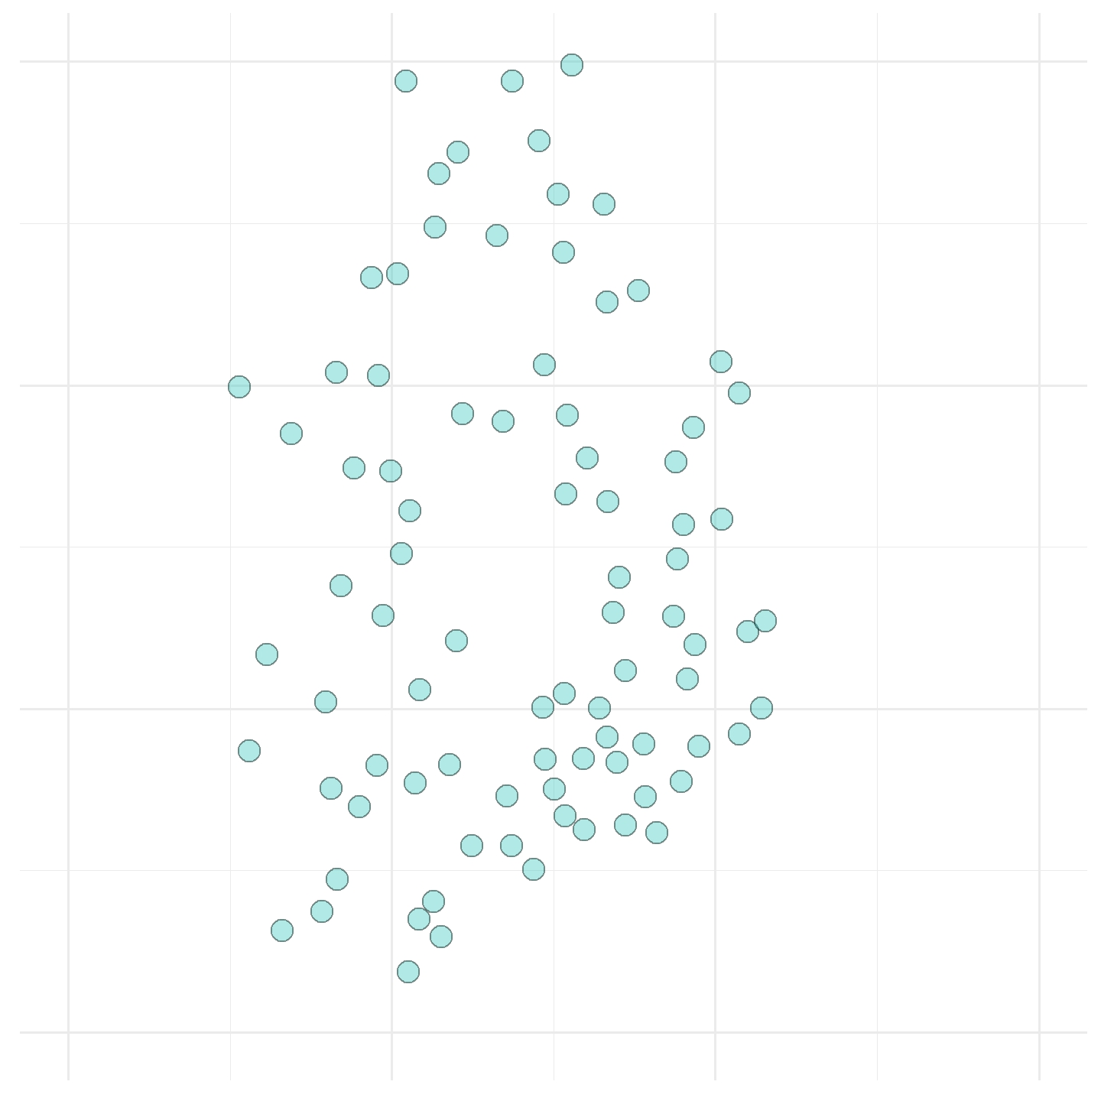
Individuals assigned identities that are consistent across all videos
Automated image processing pipeline for extracting emergence and hide times
Individual positions reconstructed into 3D
Forti
Lagun
Daaibooi
0 5 10 15 20km

Slide 2
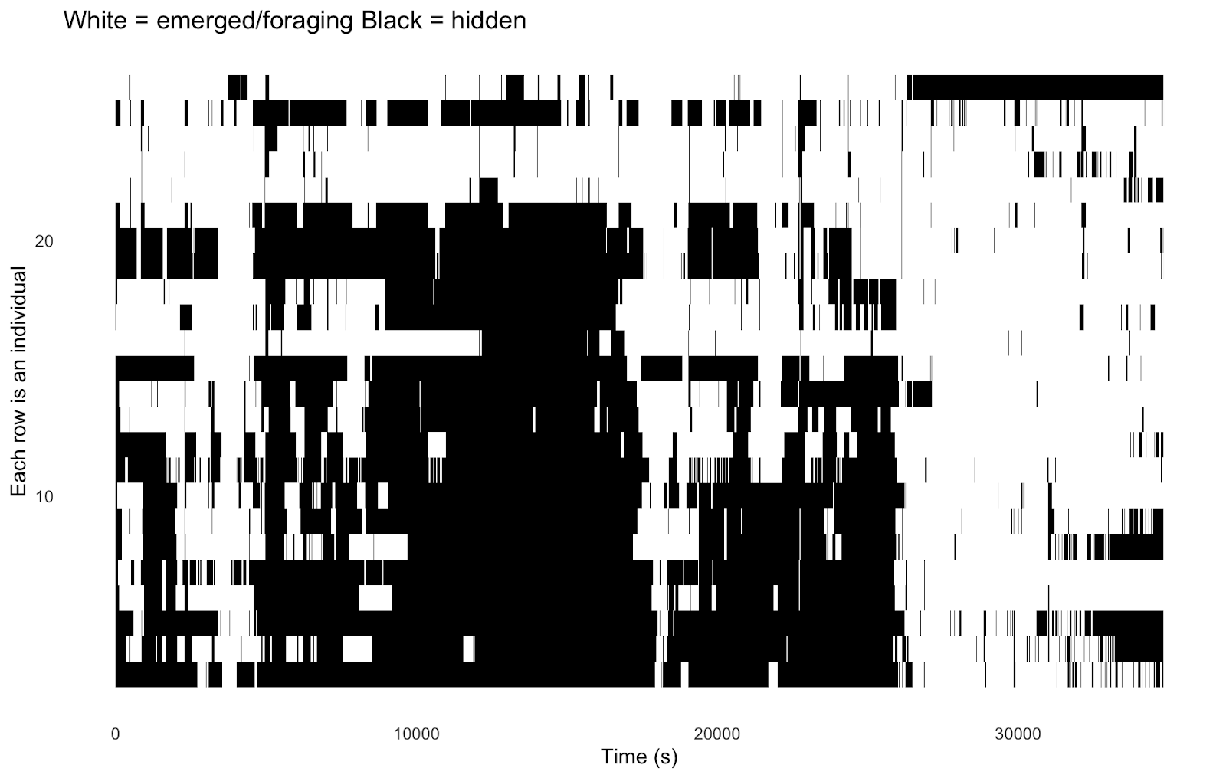
‘what is happening?’
How does foraging change across social (position in colony, colony size, behavior of others) and environmental context (site)?
‘why is it happening?’
What are the mechanistic rules underlying said patterns?

Slide 3
Personal information
Internal state
Social information
Emerged/feeding
Hidden
Internal state

Slide 4
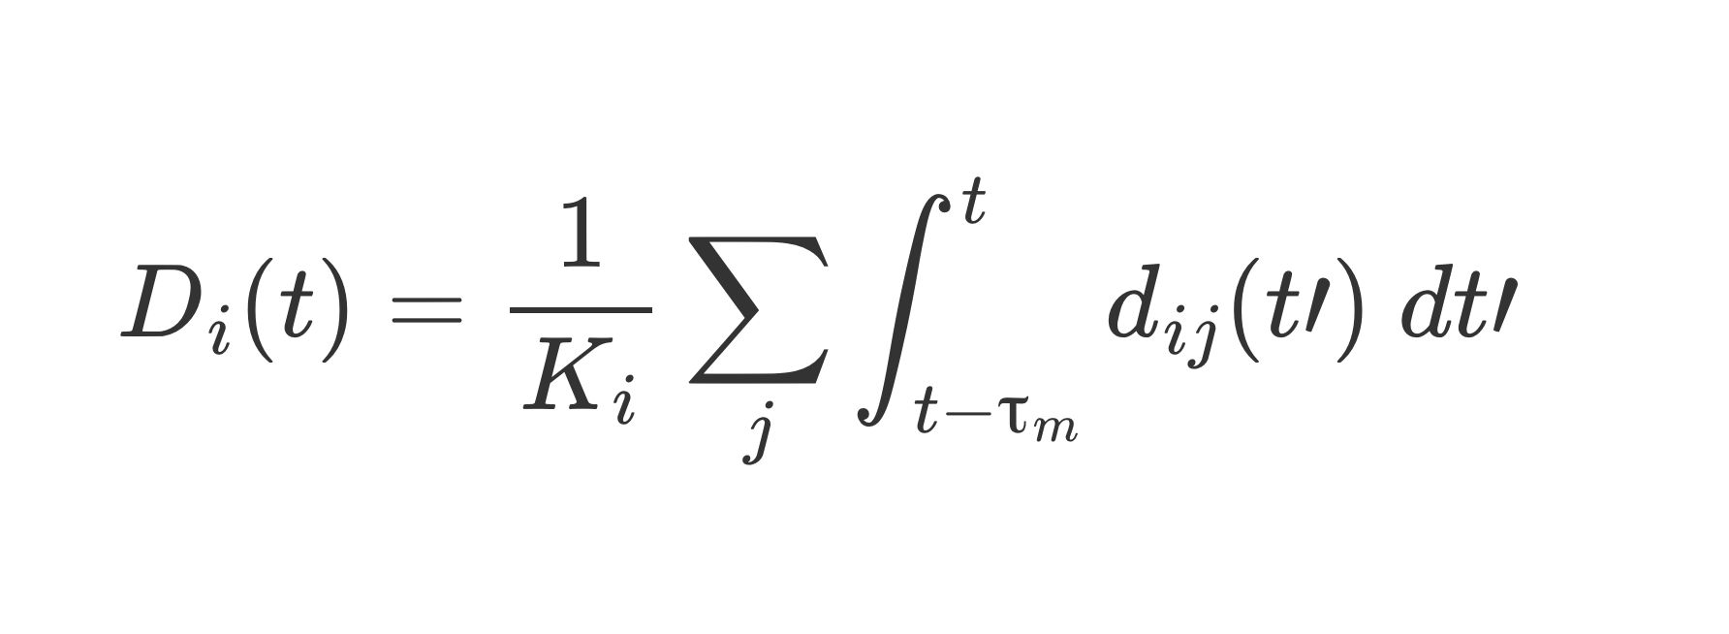
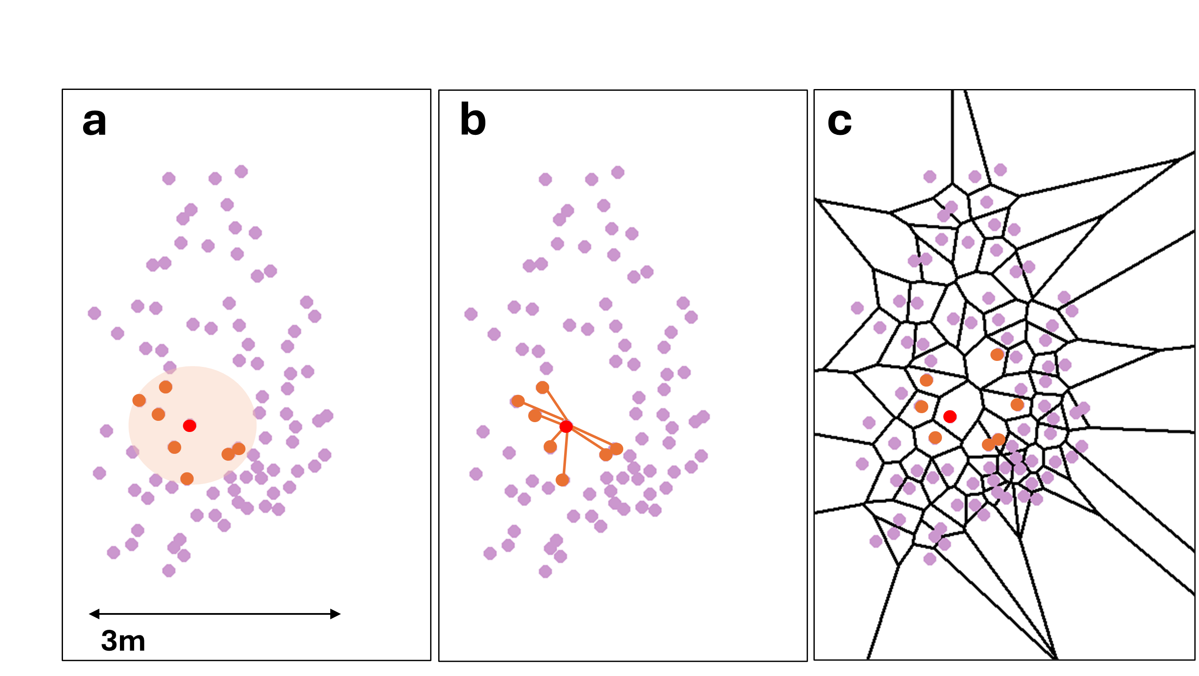
My social influence term – SIR-type model
If exceeds individual internal response threshold, hide
Cue from individual that hid within memory
Memory
Number of non-responding individuals
Interaction neighbourhood (will vary!)

Slide 5
At each time step:
For each individual:
If emerged:
If fish present / within distance threshold (??), hide (private information)
If hide activation score (generated with SIR-type model that integrates previous hides within a memory window weighted by distance and normalized by number of emerged individuals) exceeds internal response threshold, hide (social information)
If didn’t hide with private or social information, can hide based on time spent feeding (??)
If all false, remain emerged
If hidden:
Can emerge based on time spent hidden (??)
If false, remain hidden

